Slide 1
BT201
Biochemical Process Calculations
15/11/2022
(Extra lecture_Tutorial)

Slide 2
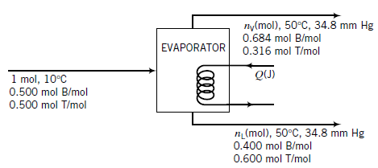
Problem 1: Partial Vaporization of a Mixture
An equimolar liquid mixture of benzene (B) and toluene (T) at 10 °C is fed continuously to a vessel
in which the mixture is heated to 50 °C. The liquid product is 40.0 mole% B, and the vapor product
is 68.4 mole% B. How much heat must be transferred to the mixture per g-mole of feed?
vapor:
benzene (B):68.4%
toluene (T)
50 °C
benzene (B)
toluene (T)
10 °C
Liquid:
benzene (B): 40%
toluene (T)
50 °C

Slide 3
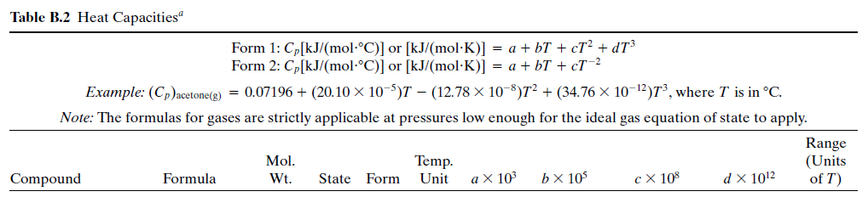

Slide 4
T_{b}: 80.1 C (benzene), 110.6 C (Toluene)

Slide 5
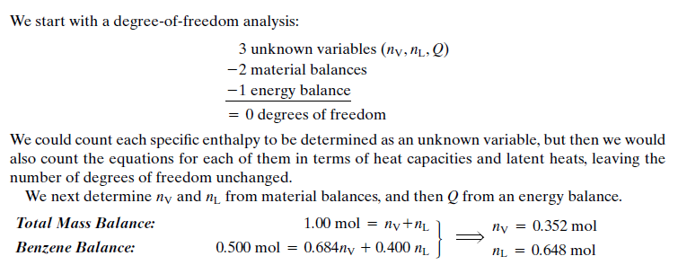
Basis: 1 mol Feed

Slide 6
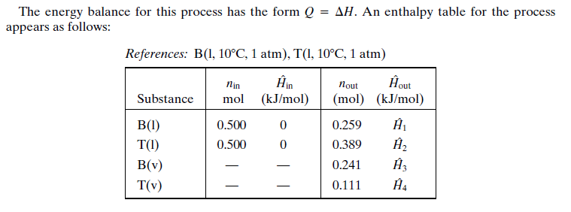
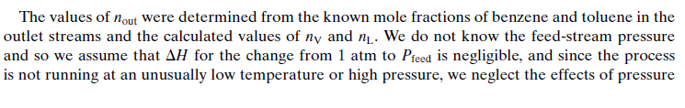
(Reference table)

Slide 7
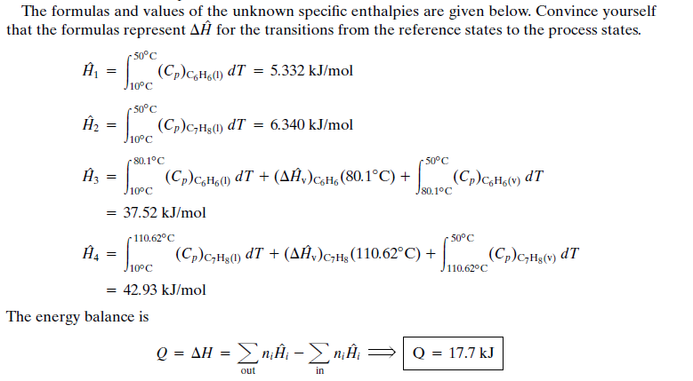
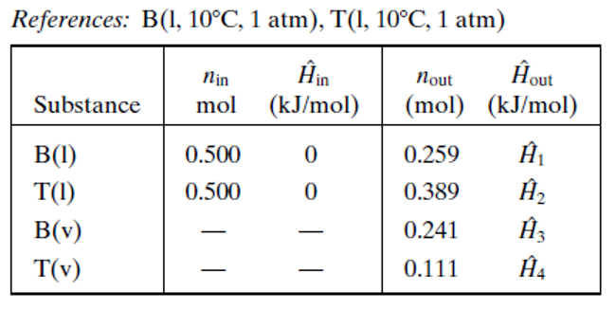

Slide 9

Problem 2

Slide 10
